Slide 1
Chapter 6 Counting
Section 3
Permutations and Combinations

Slide 2
Outline
Basic Counting Principles
The Inclusion-Exclusion Principle
The Pigeonhole Principle
Ramsey number
Permutations
Combinations
Binomial Coefficients
Generalized Permutations
Combinations with Repetition

Slide 3
Permutations
Permutations. (排列)
  A permutation of a set of distinct objects is an ordered arrangement of these objects
  An ordered arrangement of r elements of a set is called an r-permutation
  The number of r-permutation of a set with n (1≤r≤n) element is denoted by P(n, r). We can find P(n, r) using the product rule
  Note that P(n, 0) = 1 whenever n is a nonnegative integer as there is exactly one way to order zero element.
Example.
  Let S = {1, 2, 3}. The ordered arrangement 3, 1, 2 is a permutation of S. The ordered arrangement 3, 2, is a 2-permutation of S

Slide 4
Permutations
Example.
  In how many ways can we select 3 students from a group of 5 to stand in line for a picture?
  Solution.
  First note that the order in which we select students matters.
  There are 5 ways to select the 1st student
  Once the 1st student is selected, there are 4 ways to select the 2nd student in line, and 3 ways to select the last one. By product rule, there are
  5 x 4 x 3 = 60
  ways to select 3 student from a group of 5 students to stand line for picture

Slide 5
Permutations
Example.
  Let S = {a, b, c}. The 2-permutation of S are the ordered arrangements, (a, b), (a, c), (b, a), (b, c), (c, a), and (c, b)
  Consequently, there are 6 2-permutation of this set with 3 elements
  Note that there are 3 ways to choose the 1st element and then 2 ways to choose the 2nd element
  By product rule, there are P(3, 2) = 3 x 2 = 6

Slide 6
Permutations
Theorem 1.
  If n is a positive and r is an integer with 1≤r≤n, then the number of r-permutations of a set with n elements is
P(n, r) = n(n-1)(n-2)…(n-r+1)
  Proof.
  Use the product rule, the first element can be chosen in n ways. There are n-1 ways to chose the 2nd element. Likewise, there are n-2 ways to choose 3rd element, and so on until there are exactly n-(r-1) = n-r+1 ways to choose the r-th element. Thus, there are
  n∙(n-1)∙(n-2)… ∙(n-r+1)
  times of r-permutations of the set

Slide 7
Permutations
Corollary 1.
  If n and r are integers with 0≤r≤n, then P(n, r) = n!/(n-r)!
  Proof.
  When n and r are integers with 1≤r≤n, by Theorem 1 we have P(n, r) = n(n-1)…(n-r+1) = n!/(n-r)!
  As n!/(n-0)! = 1 when n is a nonnegative integer, we have P(n, r) = n/(n-r)! also holds when r = 0
Example.
  By Theorem 1, we know that if n is a positive integer, then P(n, n) = n!
Example.
  To select a 1st prize winner, a 2nd prize winner, and a 3rd prize winner from 100 different contestants, there are P(100, 3) = 100 x 99 x 98 = 970,200 ways

Slide 8
Permutations
Example.
  How many permutations of the eight letters ABCDEFGH contain string ABC?
  As ABC must occur as a block, we can find the answer by finding the permutations of 6 letters, the block ABC and the individual letters, D,E,F,G, and H. As these 6 objects can occur in any order, there are 6! = 720 permutations of the letters ABCDEFGH in which ABC occurs in a block

Slide 9
Combinations
Example.
  How many different committees of 3 students can be formed from a group of 4 students?
  We need to find the number of subsets with 3 elements from the set containing 4 students
  We see that there are 4 such subsets, one for each of the 4 students as choosing 3 students from the group is the same as choosing one of the 4 students to leave out of the group
  This means there are 4 ways to choose 3 students for the committee, where the order in which these students are chosen does not matter

Slide 10
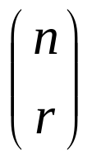
Combinations
r-Combinations. (r-组合)
  An r-combination of elements of a set is an unordered selection of r elements from the set
  An r-combination is simply a subset of the set with r elements
  Denote by C(n, r). Note that C(n, r) is also denoted by
  and is called a binomial coefficient (二项式系数)

Slide 11
Combinations
Example.
  Let S be the set {1, 2, 3, 4}. Then {1, 3, 4} is a 3-combination from S
  We see that C(4, 2) = 6, as the 2-combination of {a, b, c, d} are 6 subsets, {a, b}, {a, c}, {a, d}, {b, c}, {b, d}, and {c, d}
Remark.
  The number of r-combinations of a set with n elements can be determined using the formula for the number of r-permutations of a set
  Note that the r-permutations of a set can be obtained by first forming r-combinations and then ordering the elements in these combinations

Slide 12
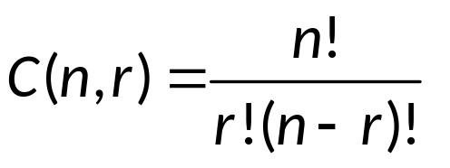

Combinations
Theorem 2.
  The number of r-combinations of a set with n elements, where n is a nonnegative integer and r is an integer with 0≤r≤n equals
  Proof.
  The r-permutations of the set can be obtained by forming the C(n, r) r-combinations and then ordering the elements in each r-permutation which can be done in P(r, r) ways

Slide 13
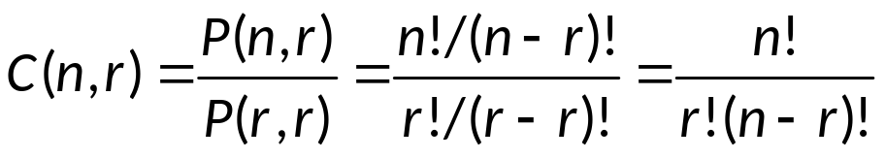
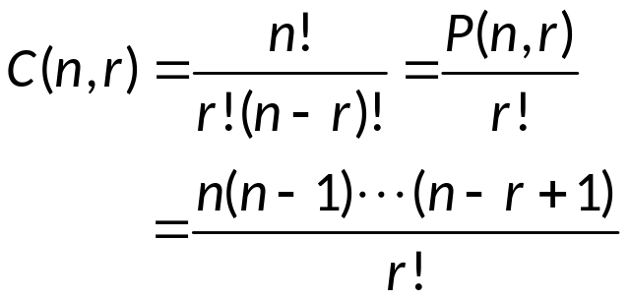
Combinations
  Proof. (continued)
  Then
Remark.
  When computing r-combination, thus canceling out all the terms in the larger factorial (that are, n! and (n-r)!)

Slide 14
Combinations
Example.
  How many poker hands of 5 cards can be dealt from a standard deck of 52 cards? Also, how many ways are there to select 47 cards from a standard deck of 52 cards?
  Solution.
  Choose 5 out of 52 cards:
  C(52, 5) = 52!/(5!47!)
  = (52x51x50x49x48)/(5x4x3x2x1)
  = 26x17x10x49x12
  = 2,598,960
  C(52, 47) = 52!/(47!5!) = 2,598,960

Slide 15
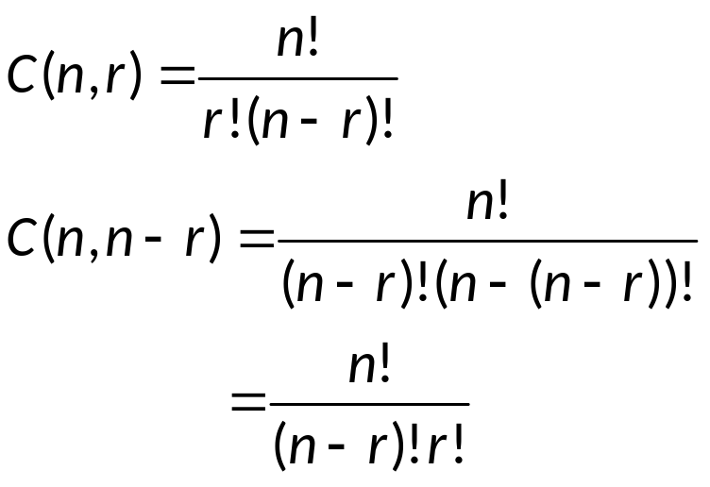
Combinations
Corollary 2.
  Let n and r be nonnegative integers with r ≤ n. Then
  C(n, r) = C(n, n-r)
  Proof.

Slide 16
Combinatorial proof
Combinatorial proof. (组合证明)
  A combinatorial proof of an identity is a proof that uses counting arguments to prove that both sides of the identity count the same objects but in different ways
Example.
  A combinatorial proof of Corollary 2
  Suppose that S is a set with n elements. Every subset A of S with r elements corresponds to a subset of S with n-r elements, i.e., ~A. Thus, C(n,r) = C(n, n-r)

Slide 17
Combinatorial proof
Example.
  How many ways are there to select 5 players from a 10-member tennis team?
  Solution.
  Choose 5 out of 10 elements, i.e.,
    C(10, 5) = 10!/(5!5!) = 252
Example.
  How many bit strings of length n contain exactly r 1’s?
  The positions of r 1’s in a bit string of length n form an r-combination of the set {1, 2, 3, …, n}. Any r-combination of the set {1, 2, 3, …, n} can determine a n-length bit string with r 1’s. Hence the answer is C(n, r)

Slide 18
Assignment
Exercises.
  Exercises after 5.3: No.5(a)(b), 6(a)(b), 20. (Ver.6)

